Slide 1
Business Consultancy – an overview
Dr Bill Sutherland
w.sutherland@rgu.ac.uk

Slide 2
Agenda and remit
A general overview of business consultancy
Perspectives on supervising and examining students engaged on business consultancy projects
NOTE: This does not over-ride or replace guidance within your module on your degree
Hopefully respond to and address any general questions received

Slide 3
Initial questions to you…
Are you planning to follow the consultancy project path within the Capstone?
Have you found a client?
Is your client within your employer’s organisation?
Is your client your line manager?
Is your client someone other than your employer?
Is your client a stakeholder in your employer’s activity (customer, supplier, regulator etc.)?

Slide 4
Key initial issues
Finding/engaging with a client
Identifying a topic
Real
Add value
Remember it is about the client, not about you, however…
Think about how you may benefit and your motivation
To complete a key deliverable of your degree
To develop expertise in a particular body of knowledge
To develop your own skills and capabilities
To deliver an authentic assessment for learning

Slide 5
Realism
Problems contextualised to everyday life
Relevance beyond the classroom
Cognitive Challenge
Higher order thinking
Ability to make decisions
Evaluative judgement
Feedback
Authentic performance
Competencies for work performance
Similar tasks to the real world
Practical value
Ability to solve problems
Formative sense
Assessment criteria known a priori
Dimensions
of
Authentic
Assessment
A summary of VILLARROEL, V. , BLOXHAM, S., BRUNA, D.,
BRUNA, C and HERRERA-SEDA, C. 2017.
Authentic assessment: creating a blueprint for course design.
Assessment & Evaluation in Higher Education
https://doi.org/10.1080/02602938.2017.1412396 published online 18 December 2017

Slide 6
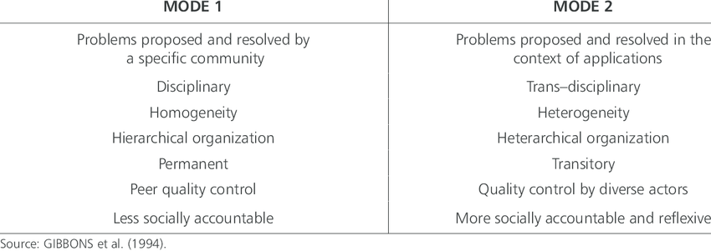
Mode 1 and Mode 2 Knowledge
GIBBONS, M. et al. 1994. The new production of knowledge: the dynamics of science and research in contemporary societies. London: Sage Publications Ltd.

Slide 7
Establishing the scope and scale of the project
Agreeing a brief
Terms of reference
Aims and objectives
Scope - what’s in/what’s out
Focus – not too narrow, nor too broad
Background and context

Slide 8
Client issues and approaches
Found client
Allocated client
Your own employer/organisation as the client
Professionalism
Concern for their time
Concern for their issue

Slide 9
Contact with your Aberdeen Business School Capstone supervisor
Supervisors are not likely to:
Know the client
Know the client’s context
Know the client’s ‘problem’
Therefore it is for the consultant (you) to bring this out – the academic supervisor will probably lack this kind of insight
A balance between guidance from the supervisor and independence of you as the consultant
We are here to guide and (hopefully) not micro-manage

Slide 10
Use and application of theory
Yes please!
Remember your degree path and focus
Be selective
Provide depth and direct relevance to ‘the problem’
Demonstrate your mastery of the ‘body of knowledge’

Slide 11
Outputs
Professional
Organised
Clear
Persuasive
Evidence-based
Recommendations
Priorities
Sequences
Key issues
Impacts

Slide 12
Confidentiality and ethics
Must be uppermost in your mind
Will require:
Navigation
Communication
Authorisation and agreement
Intellectual Property/Sensitive information/ Financial information
Internal (with the client)
Internal (with the University)
Avoid damaging reputations and trust

Slide 13
The Topic Proposal
Important to have sufficient information within this to:
Allocate an appropriate supervisor
Share and explain what the intentions for the project are
Poor/cursory/limited Topic Proposals are not a good idea!
For the consultancy project, I would wish to know:
That you have a client
That the organisation is identified
That you have an outline view of what the intention is and how this might be achieved
Maximum 200 words = Minimum 200 words (in my view!)

Slide 14
Questions? Issues? Discussion Points?

